Slide 1
Classification Algorithms
Saravana

Slide 2
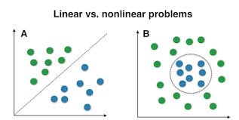
Machine Learning Relationships
A linear model uses a linear function for its prediction function or as a crucial part of its prediction function, however a Non Linear model is used when there is no Linear relationships or No curve to fit the data

Slide 3
Decision Tree
Decision Tree algorithm belongs to the family of supervised learning algorithms, A decision tree is a decision support tool that uses a tree-like graph or model of decisions and their possible consequences, including chance event outcomes, resource costs, and utility.
A decision tree is a flowchart-like structure in which each internal node represents a “test” on an attribute, each branch represents the outcome of the test, and each leaf node represents a class label, The paths from root to leaf represent classification rules.

Slide 4
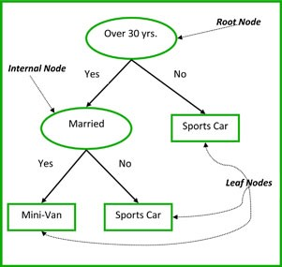
Common terms used with Decision trees:
Root Node: It represents entire population or sample and this further gets divided into two or more homogeneous sets.
Splitting: It is a process of dividing a node into two or more sub-nodes.
Decision Node: When a sub-node splits into further sub-nodes, then it is called decision node.
Leaf/ Terminal Node: Nodes do not split is called Leaf or Terminal node.
Pruning: When we remove sub-nodes of a decision node, this process is called pruning. You can say opposite process of splitting.
Branch / Sub-Tree: A sub section of entire tree is called branch or sub-tree.
Parent and Child Node: A node, which is divided into sub-nodes is called parent node of sub-nodes whereas sub-nodes are the child of parent node.

Slide 5
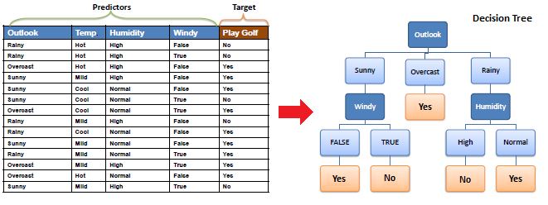
Decision Tree Algorithm for Prediction

Slide 6
Types of Decision Trees
Categorical Variable Decision Tree: Decision Tree which has categorical target variable then it called as categorical variable decision tree. E.g.:- In above scenario of student problem, where the target variable was “Student will play cricket or not” i.e. YES or NO.
Continuous Variable Decision Tree: Decision Tree has continuous target variable then it is called as Continuous Variable Decision Tree.

Slide 7
Modelling Approach for Decision Tree
Both Gini and entropy are measures of impurity of a node. A node having multiple classes is impure whereas a node having only one class is pure.
Entropy
Its the amount of information that's gained by knowing the value of the attribute, which is the entropy of the distribution before the split minus the entropy of the distribution after it.
Gini Index
It measures the degree or probability of a particular variable being wrongly classified when it is randomly chosen.

Slide 8
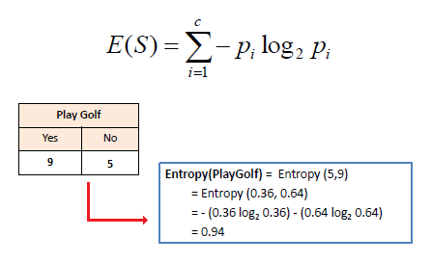
ID3 (Entropy) Formula
Step1 - Calculate the Entropy of the Target

Slide 9
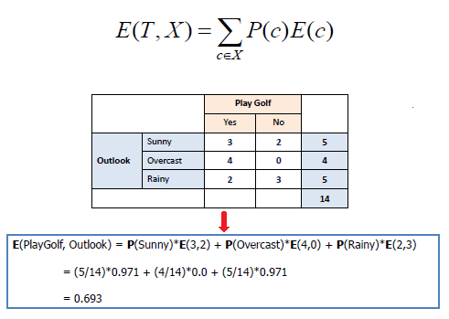
ID3 (Entropy) Formula
Step2 - Calculate the Entropy of Each Column or Feature

Slide 10
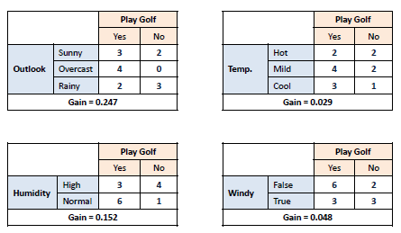
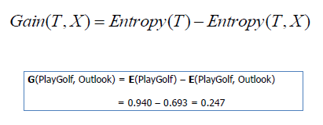
ID3 (Entropy) Formula
Step3 - Calculate the information Gain based on the Entropy Calculated

Slide 11
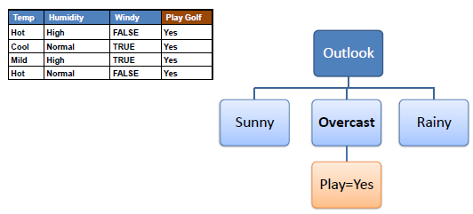
ID3 (Entropy) Formula
Step4 - Choose attribute with the largest information gain as the decision node, divide the dataset by its branches and repeat the same process on every branch.
Step5 - The ID3 algorithm is run recursively on the non-leaf branches, until all data is classified.

Slide 12
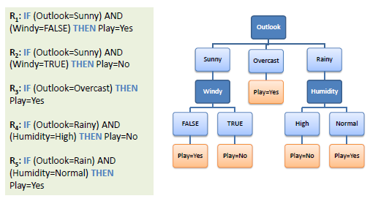
Decision Tree to Decision Rules

Slide 13
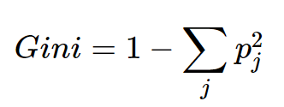
Gini Index
Gini index or Gini impurity measures the degree or probability of a particular variable being wrongly classified when it is randomly chosen, A Gini Index of 0.5 denotes equally distributed elements into some classes.

Slide 14
Gini Index Calculation
Outlook | Yes | No | Number of instances
Sunny | 2 | 3 | 5
Overcast | 4 | 0 | 4
Rain | 3 | 2 | 5
Gini(Outlook=Sunny)=1–(2/5)2–(3/5)2=1–0.16–0.36=0.48
Gini(Outlook=Overcast)=1–(4/4)2–(0/4)2=0Gini(Outlook=Overcast)=1–(4/4)2–(0/4)2=0
Gini(Outlook=Rain)=1–(3/5)2–(2/5)2=1–0.36–0.16=0.48
Gini(Outlook)=(5/14)×0.48+(4/14)×0+(5/14)×0.48=0.171+0+0.171=0.342

Slide 15
Gini Index Calculation
Temperature | Yes | No | Number of instances
Hot | 2 | 2 | 4
Cool | 3 | 1 | 4
Mild | 4 | 2 | 6
Gini(Temp=Hot) =1–(2/4)2–(2/4)2=0.5
Gini(Temp=Cool) =1–(3/4)2–(1/4)2=1–0.5625–0.0625=0.375
Gini(Temp=Mild) =1–(4/6)2–(2/6)2=1–0.444–0.111=0.445
Gini(Temp) =(4/14)×0.5+(4/14)×0.375+(6/14)×0.445=0.142+0.107+0.190=0.439

Slide 16
Gini Index Calculation
Humidity | Yes | No | Number of instances
High | 3 | 4 | 7
Normal | 6 | 1 | 7
Gini(Humidity=High)=1–(3/7)2–(4/7)2=1–0.183–0.326=0.489
Gini(Humidity=Normal)=1–(6/7)2–(1/7)2=1–0.734–0.02=0.244
Gini(Humidity)=(7/14)×0.489+(7/14)×0.244=0.367

Slide 17
Gini Index Calculation
Wind | Yes | No | Number of instances
Weak | 6 | 2 | 8
Strong | 3 | 3 | 6
* We’ve calculated Gini index values for each feature. The winner will be outlook feature because its cost is the lowest.
Gini(Wind=Weak) =1–(6/8)2–(2/8)2=1–0.5625–0.062=0.375
Gini(Wind=Strong) =1–(3/6)2–(3/6)2=1–0.25–0.25=0.5
Gini(Wind) =(8/14)×0.375+(6/14)×0.5=0.428

Slide 18
Applications of Decision Tree
Variable selection. The number of variables that are routinely monitored in clinical settings has increased dramatically with the introduction of electronic data storage. Many of these variables are of marginal relevance and, thus, should probably not be included in data mining exercises. Like stepwise variable selection in regression analysis, decision tree methods can be used to select the most relevant input variables that should be used to form decision tree models, which can subsequently be used to formulate clinical hypotheses and inform subsequent research.
Assessing the relative importance of variables. Once a set of relevant variables is identified, researchers may want to know which variables play major roles. Generally, variable importance is computed based on the reduction of model accuracy (or in the purities of nodes in the tree) when the variable is removed. In most circumstances the more records a variable have an effect on, the greater the importance of the variable.
Prediction & Classification. This is one of the most important usages of decision tree models. Using the tree model derived from historical data, it’s easy to predict & classify the result for future records.
Data manipulation. Too many categories of one categorical variable or heavily skewed continuous data are common in medical research. In these circumstances, decision tree models can help in deciding how to best collapse categorical variables into a more manageable number of categories or how to subdivide heavily skewed variables into ranges

Slide 19
Random Forest
We can see it from its name, which is to create a forest with lots of trees created randomly.
It creates decision trees on data samples and then gets the prediction from each of them and finally selects the best solution by means of voting. It is an ensemble method which is better than a single decision tree because it reduces the over-fitting by averaging the result.

Slide 20
Working of Random Forest Algorithm
Step 1 − First, start with the selection of random samples from a given dataset.
Step 2 − Next, this algorithm will construct a decision tree for every sample. Then it will get the prediction result from every decision tree.
Step 3 − In this step, voting will be performed for every predicted result.
Step 4 − At last, select the most voted prediction result as the final prediction result.

Slide 21
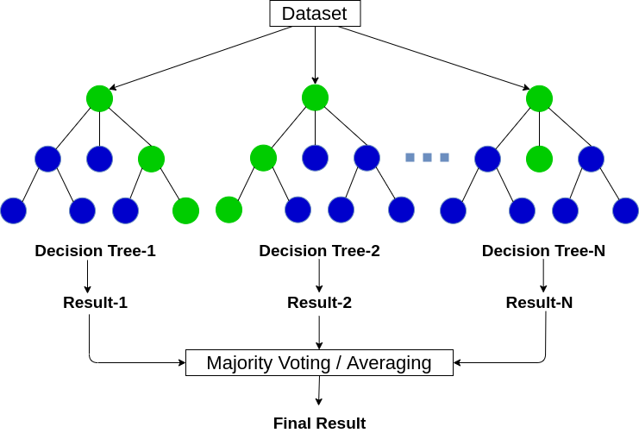
Random Forest

Slide 22
Decision Tree Vs Random Forest
A Decision support tool that uses a tree-like graph or model of decisions and their possible consequences, including change event outcomes, resources costs, and utility.
There is a possibility of overfitting.
Gives less accurate results.
Simpler and easier to understand, construct and visualize.
Its interpretable
An Ensemble learning method that operates by constructing a multitude of decision trees at training time and outputting the class depending on the individual trees.
Reduced risk of overfitting.
Give more accurate results.
Comparatively more complex.
Its not interpretable

Slide 23
KNN
K-Nearest Neighbours (KNN) is one of the simplest algorithms used in Machine Learning for regression and classification problem. KNN algorithms use data and classify new data points based on similarity measures (e.g. distance function).
When do we use KNN algorithm?
KNN can be used for both classification and regression predictive problems. However, it is more widely used in classification problems in the industry. To evaluate any technique we generally look at 3 important aspects:
1. Ease to interpret output
2. Calculation time
3. Predictive Power

Slide 24
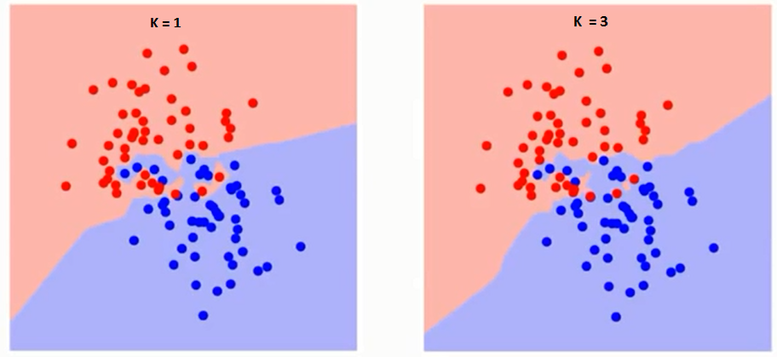
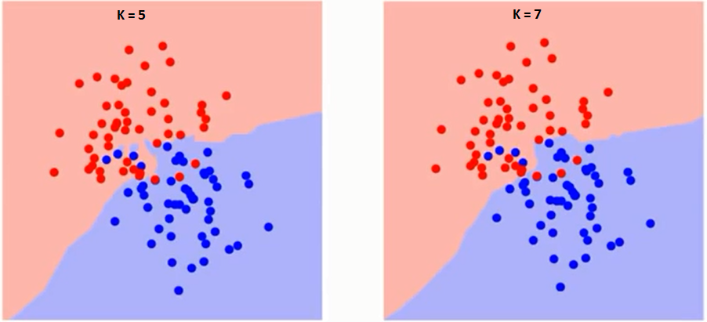
How do we choose the factor K?
The boundary becomes smoother with increasing value of K.
the error rate at K=1 is always zero for the training sample. This is because the closest point to any training data point is itself. Hence the prediction is always accurate with K=1.
If validation error curve would have been similar, our choice of K would have been 1. Following is the validation error curve with varying value of K:

Slide 25
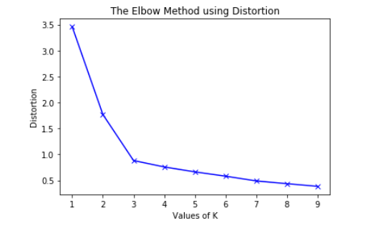
Elbow Method for optimal value of k

Slide 26
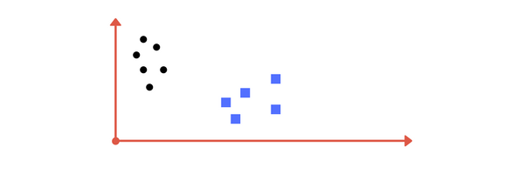
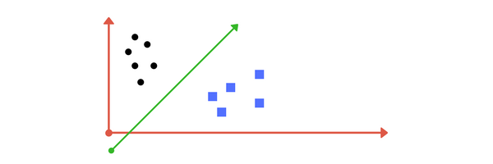
Support Vector Machines
Separating hyperplane - optimal hyperplane which categorizes new examples

Slide 27
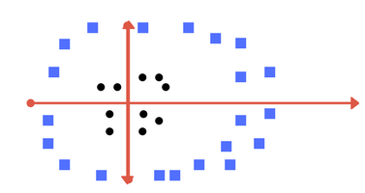
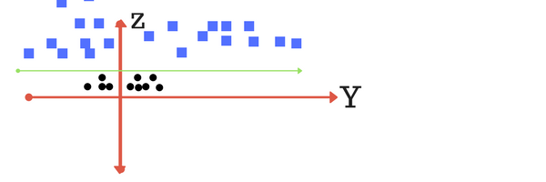
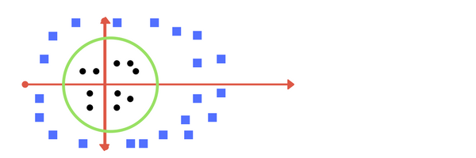
Making it a Bit complex
there is no line that can separate the two classes in an x-y plane….
So what do we do? We apply transformation and add one more dimension as we call it z-axis

Slide 28
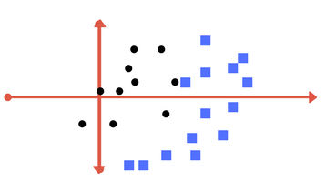
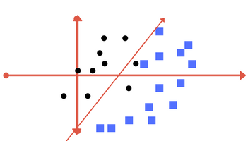
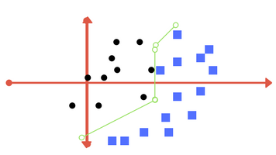
Making it a little more complex…
What if data plot overlaps? Or, what in case some of the black points are inside the blue ones? Which line among 1 or 2?should we draw?

Slide 29
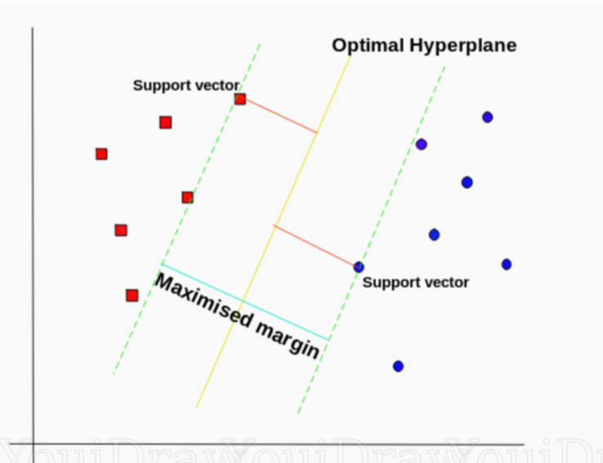
Hyperplane
Thus SVM tries to make a decision boundary in such a way that the separation between the two classes(that street) is as wide as possible.

Slide 30
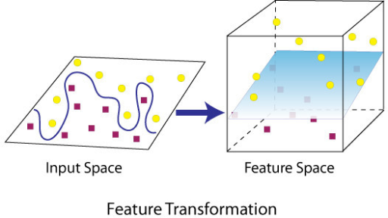
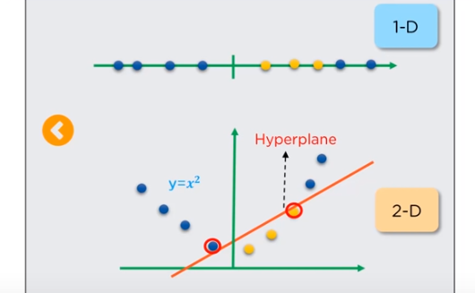
Application of SVM modeling

Slide 31
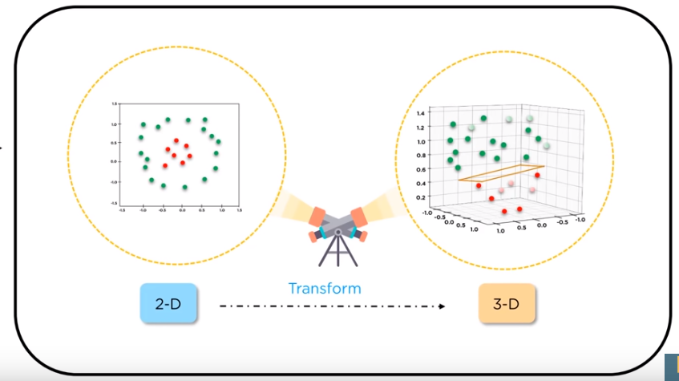
Kernel trick

Slide 32
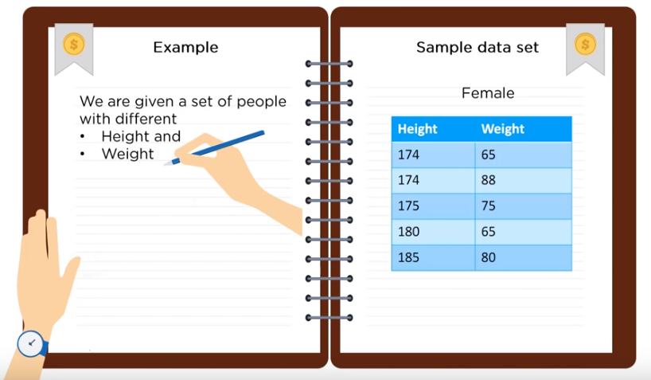
Example

Slide 33
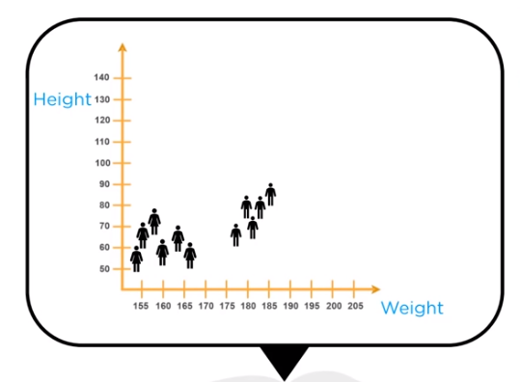
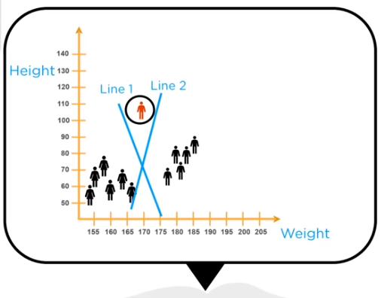
Creating the Hyperplane

Slide 34
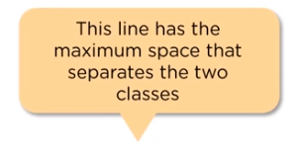
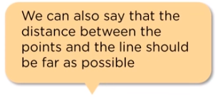
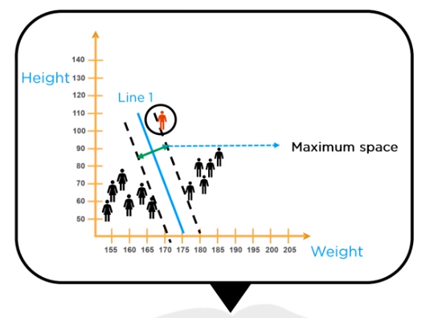
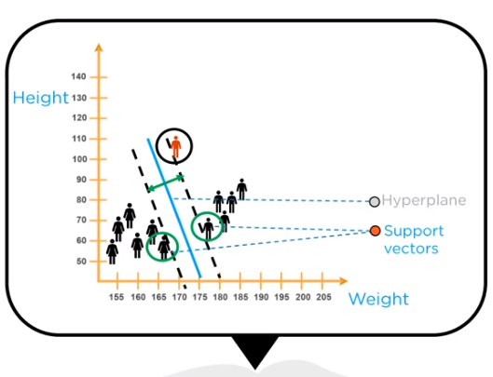
Line of Best Fit

Slide 35
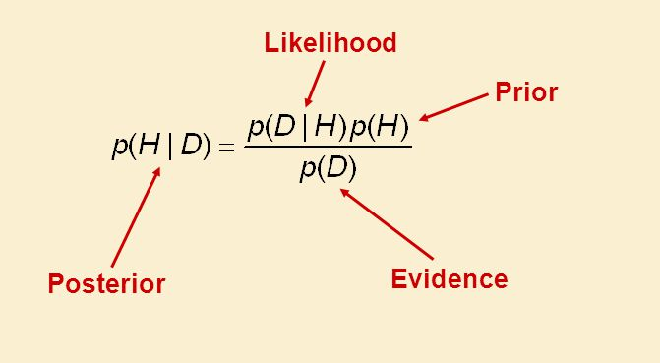
Bayes' theorem
Bayes’ Theorem is a way of finding a probability when we know certain other probabilities.
The formula is
Which tells us: | how often H happens given that D happens, written P(H|D),
When we know: | how often D happens given that H happens, written P(D|H)
 | and how likely H is on its own, written P(H)
 | and how likely D is on its own, written P(D)
First think "AB AB AB" then remember to group it like: "AB = A BA / B"

Slide 36
Joint, Marginal & Conditional Probability
Marginal probability: the probability of an event occurring (p(A)), it may be thought of as an unconditional probability. It is not conditioned on another event. Example: the probability that a card drawn is red (p(red) = 0.5). Another example: the probability that a card drawn is a 4 (p(four)=1/13).
Joint probability: p(A and B). The probability of event A and event B occurring. It is the probability of the intersection of two or more events. The probability of the intersection of A and B may be written p(A ∩ B). Example: the probability that a card is a four and red =p(four and red) = 2/52=1/26. (There are two red fours in a deck of 52, the 4 of hearts and the 4 of diamonds).
Conditional probability: p(A|B) is the probability of event A occurring, given that event B occurs. Example: given that you drew a red card, what’s the probability that it’s a four (p(four|red))=2/26=1/13. So out of the 26 red cards (given a red card), there are two fours so 2/26=1/13.

Slide 37
What are the Pros and Cons of Naive Bayes?
Pros:
It is easy and fast to predict class of test data set. It also perform well in multi class prediction
When assumption of independence holds, a Naive Bayes classifier performs better compare to other models like logistic regression and you need less training data.
It perform well in case of categorical input variables compared to numerical variable(s). For numerical variable, normal distribution is assumed (bell curve, which is a strong assumption).
Cons:
If categorical variable has a category (in test data set), which was not observed in training data set, then model will assign a 0 (zero) probability and will be unable to make a prediction. This is often known as “Zero Frequency”. To solve this, we can use the smoothing technique. One of the simplest smoothing techniques is called Laplace estimation.
On the other side naive Bayes is also known as a bad estimator, so the probability outputs from predict_proba are not to be taken too seriously.
Another limitation of Naive Bayes is the assumption of independent predictors. In real life, it is almost impossible that we get a set of predictors which are completely independent.

Slide 38
Applications of Naive Bayes Algorithms
Real time Prediction: Naive Bayes is an eager learning classifier and it is sure fast. Thus, it could be used for making predictions in real time.
Multi class Prediction: This algorithm is also well known for multi class prediction feature. Here we can predict the probability of multiple classes of target variable.
Text classification/ Spam Filtering/ Sentiment Analysis: Naive Bayes classifiers mostly used in text classification (due to better result in multi class problems and independence rule) have higher success rate as compared to other algorithms. As a result, it is widely used in Spam filtering (identify spam e-mail) and Sentiment Analysis (in social media analysis, to identify positive and negative customer sentiments)
Recommendation System: Naive Bayes Classifier and Collaborative Filtering together builds a Recommendation System that uses machine learning and data mining techniques to filter unseen information and predict whether a user would like a given resource or not

Slide 39
Gradient Boosting
Most of the magic is described in the name: “Gradient” plus “Boosting”.
A loss function to be optimized.
A weak learner to make predictions.
An additive model to add weak learners to minimize the loss function.
The gradient is nothing, but the partial derivative of our loss function - so it describes the steepness of our error function

Slide 40
Steps in Gradient Descent
1. Loss Function
The loss function used depends on the type of problem being solved.
It must be differentiable, but many standard loss functions are supported and you can define your own.
For example, regression may use a squared error and classification may use logarithmic loss.
2. Weak Learner to Strong Learner
Decision trees are used as the weak learner in gradient boosting.
Trees are constructed in a greedy manner, choosing the best split points based on purity scores like Gini or to minimize the loss.
3. Additive Model
Trees are added one at a time, and existing trees in the model are not changed.
A gradient descent procedure is used to minimize the loss when adding trees.

Slide 41
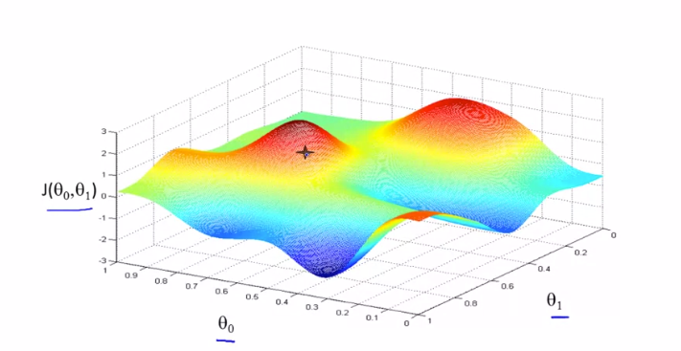
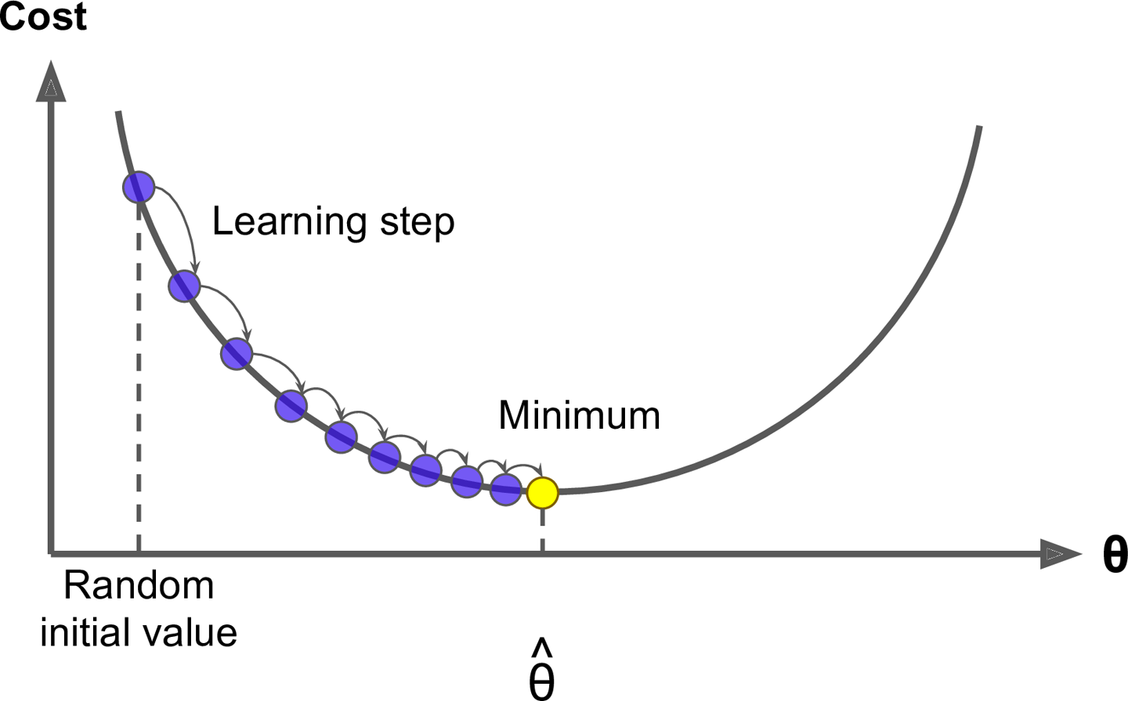
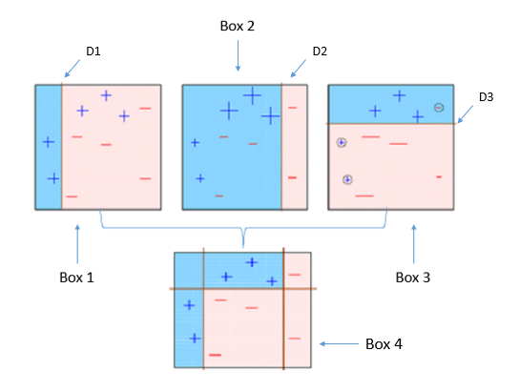
Gradient Descent

Slide 42
XGBoost
XGBoost stands for eXtreme Gradient Boosting.
Three main forms of gradient boosting are supported:
Gradient Boosting algorithm also called gradient boosting machine including the learning rate.
Stochastic Gradient Boosting with sub-sampling at the row, column and column per split levels.
Regularized Gradient Boosting with both L1 and L2 regularization.

Slide 43
Parameters Tuning
the number of iterations (i.e. the number of trees to ensemble),
the number of observations in each leaf,
tree complexity and depth,
the proportion of samples and
the proportion of features on which to train on.

Slide 44
Thanks

